Slide 1

Engineering Mathematics-II
UNIT-I
Lecture-1
RANK OF A MATRIX
Dr.c.vijender
Associate Professor of Mathematics
SNIST

Slide 2
Applications of Matrices:
Graph Theory:
The adjacency matrix of a finite graph is a basic notion of graph theory.
2. Linear combinations of quantum states in physics:
The first model of quantum mechanics by

Slide 3
Heisenberg in 1925 represented the theory’s operators by infinite-dimensional matrices acting on quantum states. This is also referred to as matrix mechanics.
3. Computer Graphics:
4x4 transformation rotation matrices are commonly used in computer graphics.

Slide 4
4. Solving linear equations:
Using Row reduction
Cramer’s rule(Determinants)
Using the inverse matrix
5. Cryptography.
Cryptography is concerned with keeping communications private.

Slide 5
We discuss the following in today’s Lecture:
Minor of a Matrix
Rank of matrix
Important results of Rank of a matrix
Zero Row and non- zero Row
Echelon form of a matrix

Slide 6
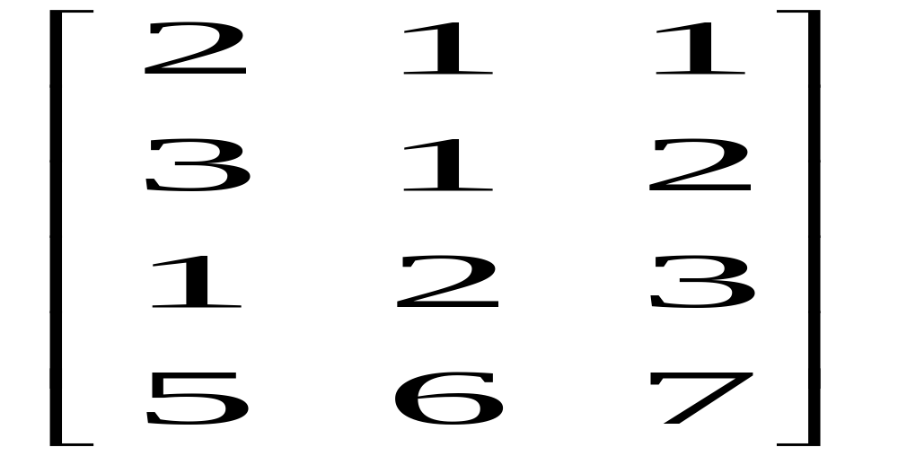
Minor of a Matrix:
Let A be an m×n matrix. The determinant of a square sub-matrix of A is called a minor of the matrix. If the order of the square sub-matrix is t then its determinant is called a minor of order t.
e.g : Let A= be a matrix

Slide 7
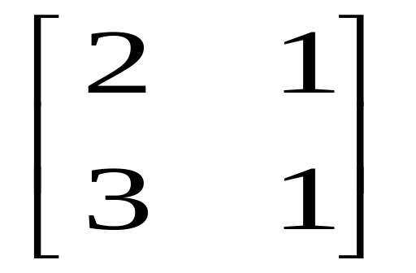
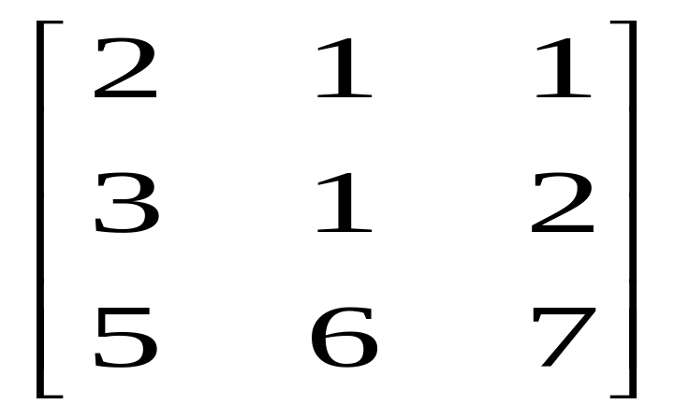
We have B= is a sub matrix of order 2
Det B= 2-3 = -1 is a minor of order 2 and
C = is a sub-matrix of order 3.
Det C = -8 is a minor of order 3.

Slide 8
Rank of a matrix :
Let A be an m×n matrix. If A is a null matrix , we define its rank to be 0(zero) .
If A is a non-zero matrix, we say that r is the rank of A if
(i) every (r+1)^{th} order minor of A is 0 and
(ii) there exists at least one r^{th} order minor of A

Slide 9
which is not zero.
Rank of A is denoted by ρ(A).
Note: 1) It can be noted that the rank of a non-zero matrix is the order of the highest order non-zero minor of A.
2) i) Every matrix will have a rank
ii) Rank of a matrix is unique

Slide 10
iii) ρ(A) ≥1 when A is a non-zero matrix
iv) If A is a matrix of order m×n, rank of A = ρ (A) ≤ min (m, n).
v) If ρ (A) = r, then every minor of A of order r+1, or more is zero.
Rank of the identity matrix I_{n} is n.

Slide 11
If A is a matrix of order n and A is non singular (i.e., det A≠0), then ρ(A) =n.
Important Results :
1. The rank of a matrix is ≤r, if all minors of (r+1)^{th} order vanish.
2. The rank of a matrix is ≥r, if there is at least one minor of r^{th} order which is not equal to zero.

Slide 12
3. If A and B are two equivalent matrices, then rank of A = rank of B.
4. If two matrices A and B have the same size and same rank, then the two matrices A and B are equivalent.
5. Elementary operations on a matrix do not change its rank.

Slide 13

6. The rank of the transpose of a matrix is the same as that of the original matrix.
Find the rank of the matrix A =
Sol : det A = -1 (18-1) - 0 (9+5) + 6 (3+30)=181 ≠ 0
Since the minor ≠ 0 of order 3
∴ ρ (A) = 3

Slide 14

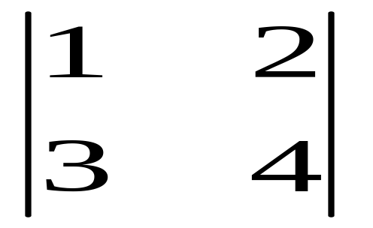
2) Find the rank of the matrix
Sol : det A = 0
∴ Rank of A≠3 ,
so, it must be less than 3.
Consider a minor of order 2 = = 4-6 = -2 ≠0

Slide 15

Hence, there is at least one minor of order 2 which is not zero.
∴ Rank of A = 2.
Find the rank of the matrix
Sol : Here the matrix is of order 3 × 4
Its rank ≤ min (3,4) = 3

Slide 16
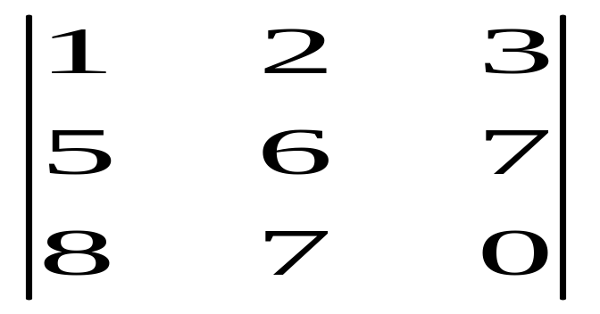
∴Highest order of the minor will be 3
Let us consider the minor
Its determinant = 24 ≠ 0
∴ the highest order of the minor is 3
Hence Rank of A = 3.

Slide 17
Zero Row and non- zero Row :
If all the elements in a row of a matrix are zeros then it is called a zero row and if there is at least one non-zero element in a row, then it is called a non zero row.

Slide 18
Echelon form of a matrix :
A matrix is said to be in Echelon form if it has the following properties :
i) zero rows, if any, are below any non-zero row.
ii) The first non-zero entry in each non-zero row is equal to 1.

Slide 19
The number of zeros before the first non-zero element in a row is less than the number of such zeros in the next row.
Note : The condition (ii) is optional.
Important Result : The number of non zero rows in the row echelon form of a matrix A is the rank of A.

Slide 20
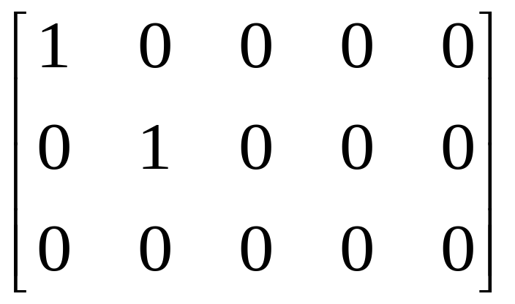
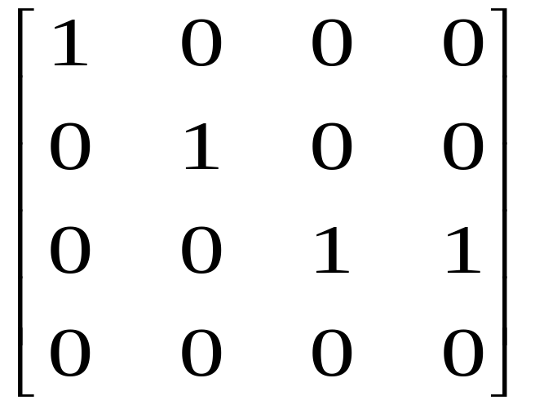
e.g 1) is a row echelon form.
e.g 2) is in row echelon form.

Slide 21
We discuss the following in next Lecture:
Echelon form of a matrix.
Normal form of a matrix.

Slide 22

MATHEMATICS FOR BIOTECHNOLOGY –II
UNIT-I
Lecture-2
RANK OF A MATRIX-Echelon AND NORMAL form
Dr.c.vijender
Associate Professor of Mathematics
SNIST

Slide 23
We discussed the following in previous Lecture:
Minor of a Matrix
Rank of matrix
Important results of Rank of a matrix
Zero Row and non- zero Row
Echelon form of a matrix

Slide 24
We discuss the following in today’s Lecture:
Echelon form of a matrix(continued…).
Normal form of a matrix.

Slide 25


e.g 3) Reduce the matrix A =
into echelon form and hence find its rank
Sol : Given matrix A =
Applying R₂ → R₂ + (-3)R_{1,} A ∼
R₃ →R₃ + (-7) R₁

Slide 26

A ∼
This is in Echelon form and the number of non-zero rows is 3.
Rank (A) = ρ(A) = 3
Applying R₃ →R₃ + (-2) R₂

Slide 27
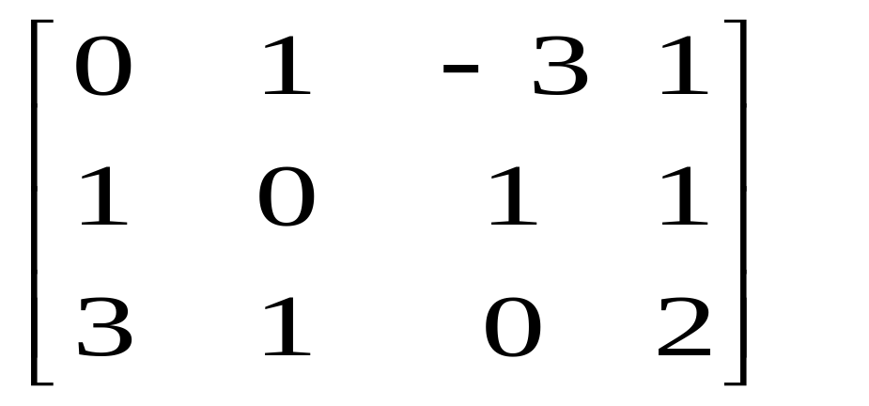
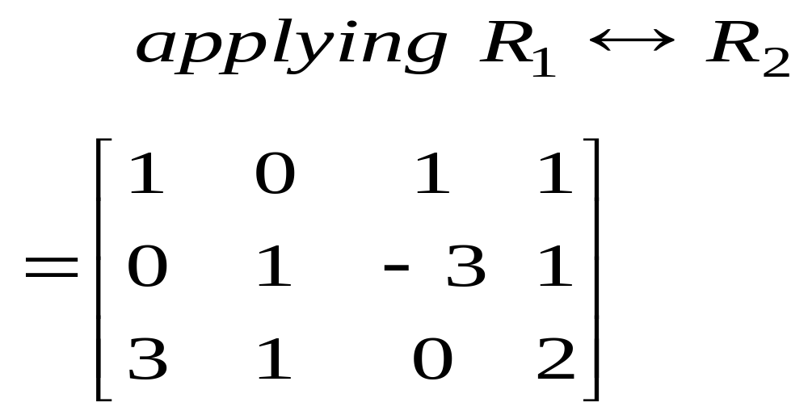
4) Reduce the matrix into Echelon form and hence find its rank.
Solution: Let A =

Slide 28
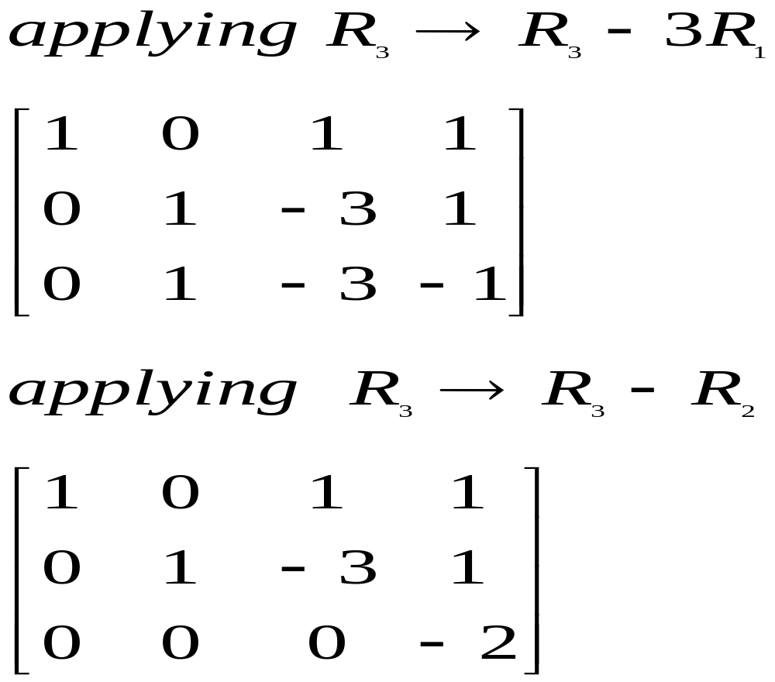
Which is in echelon form. Rank of A=3.

Slide 29
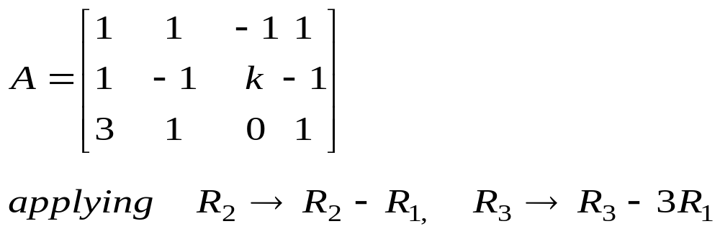
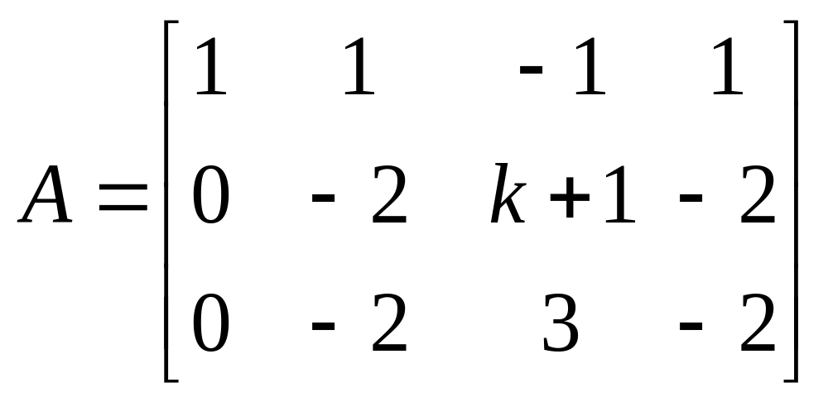
e.g.5) Find the value of k such that the rank is 2.
where
Sol:

Slide 30
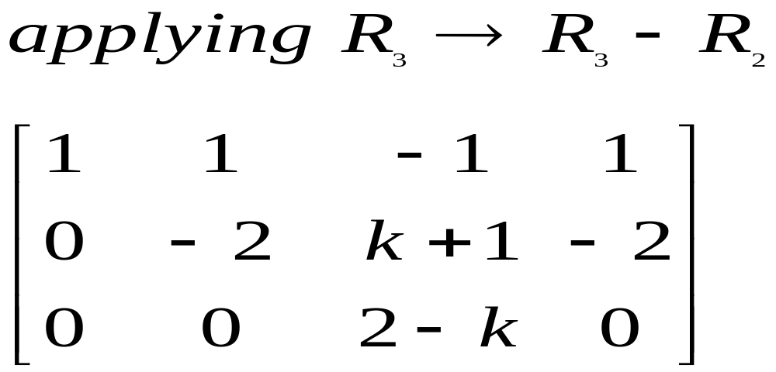
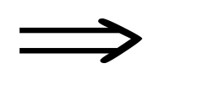
Since the rank of A is 2, there will be only two non-zero rows. Therefore, third row must be a zero row. 2-k =0 k=2.

Slide 31
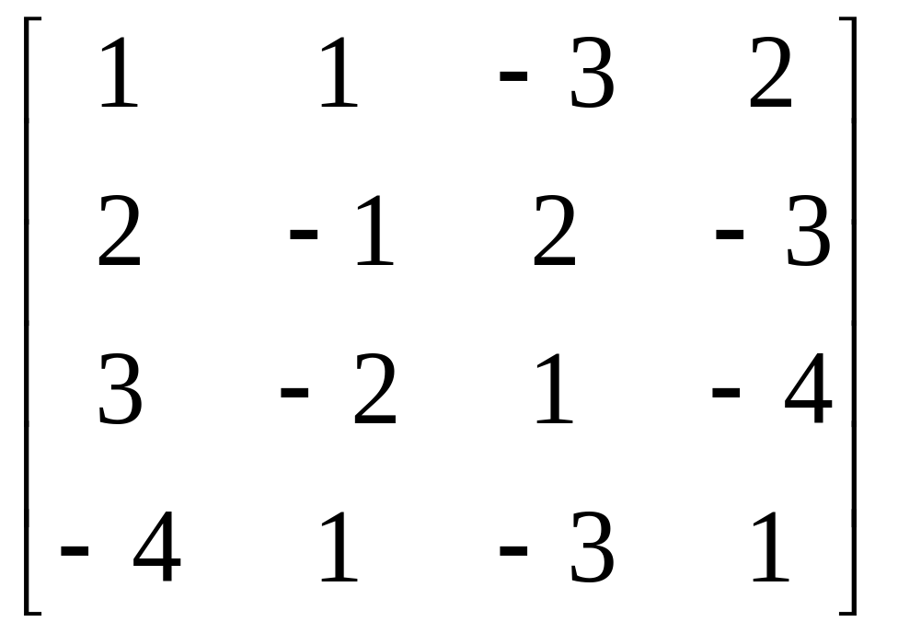
e.g.6) Reduce the matrix to echelon form and find its rank

Slide 32
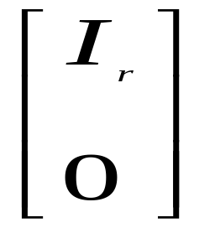
Normal form :
This is another method of finding rank of a matrix.
Every m × n matrix of rank r can be reduced to the form I_{r} , [I_{r} , 0] or by a finite chain of elementary row or column operations, Where I_{r} is the r-rowed unit matrix.

Slide 33

e.g 1)Reduce the matrix A = to
canonical form (normal) and hence find its ank.
Sol : Given A =

Slide 34
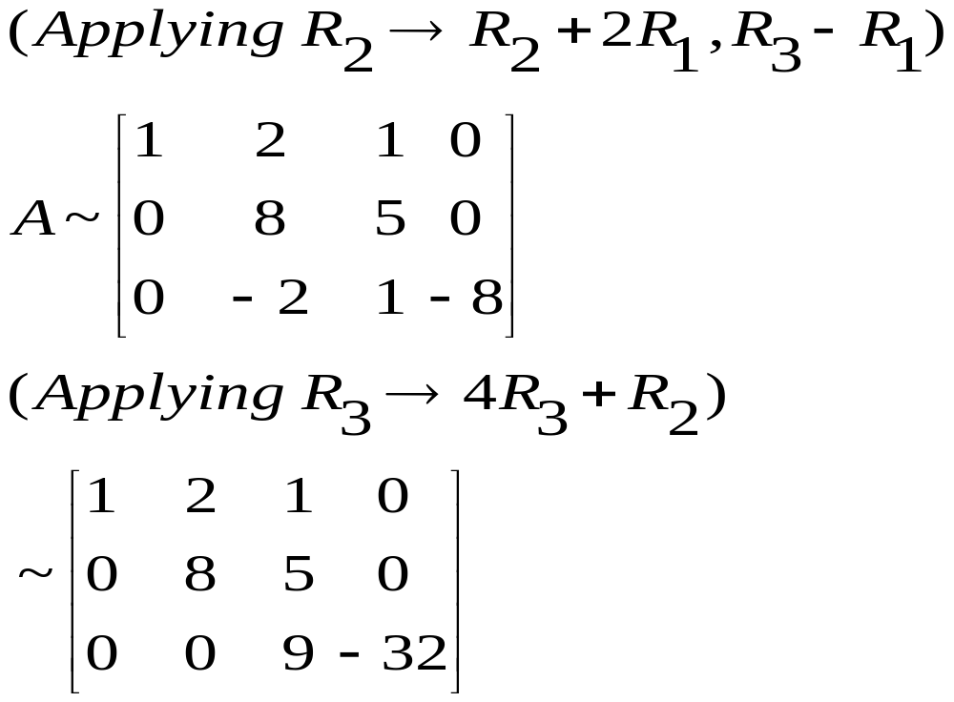

Slide 35
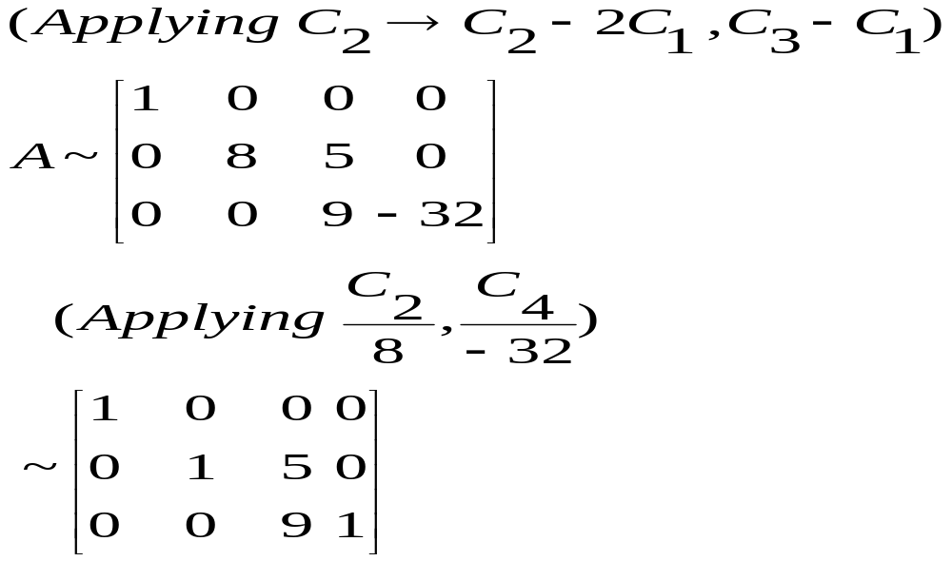
Contd.,

Slide 36
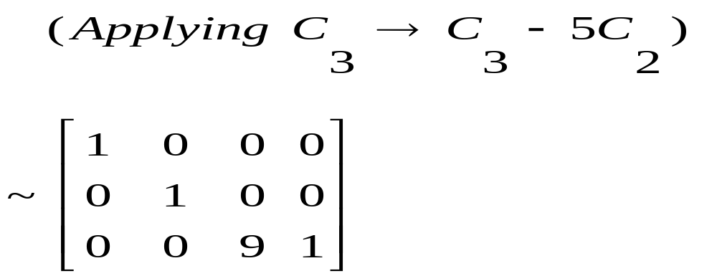
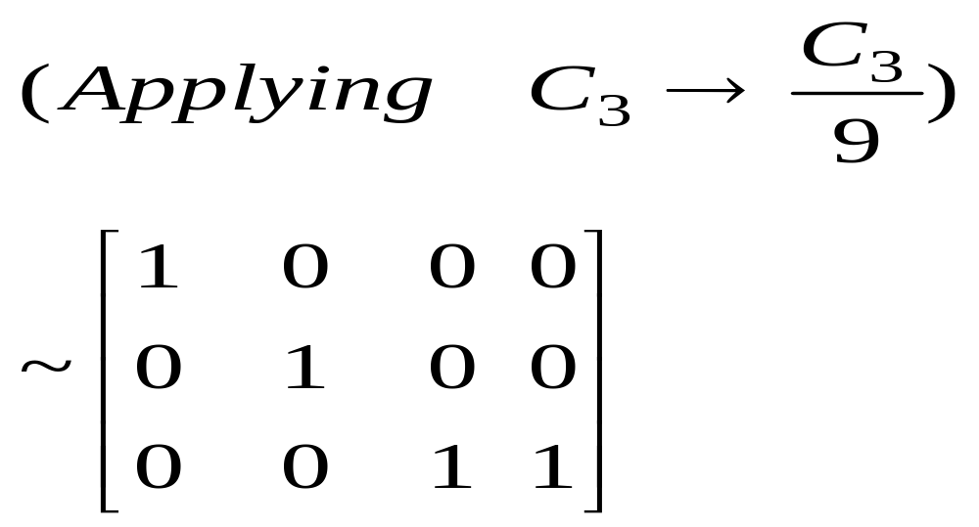

Slide 37
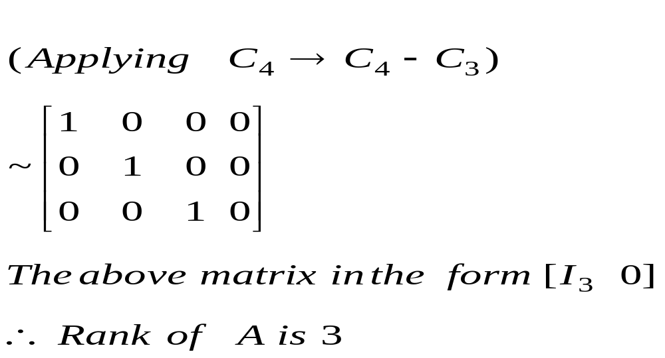

Slide 38
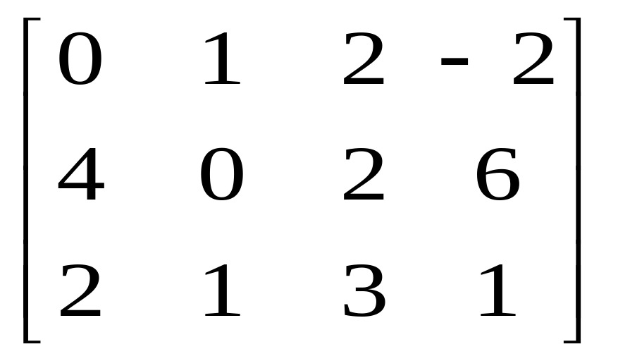
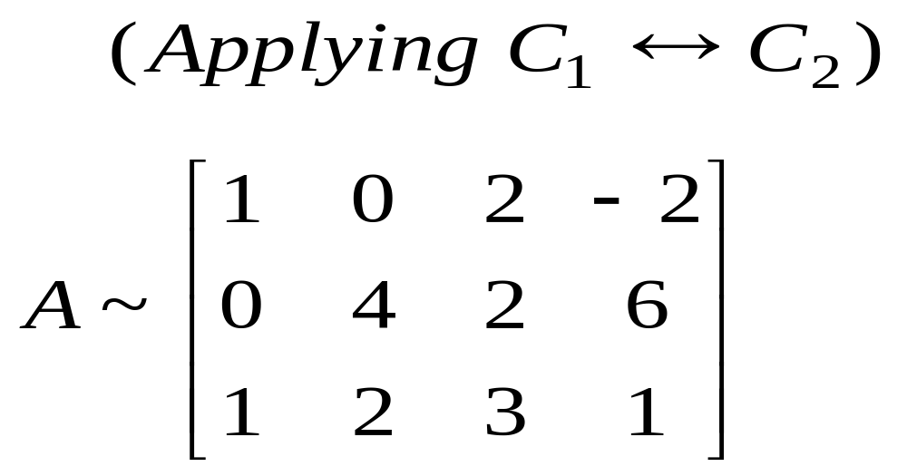
e.g. 2) Reduce the matrix to normal form
and hence find the rank .
Sol:

Slide 39
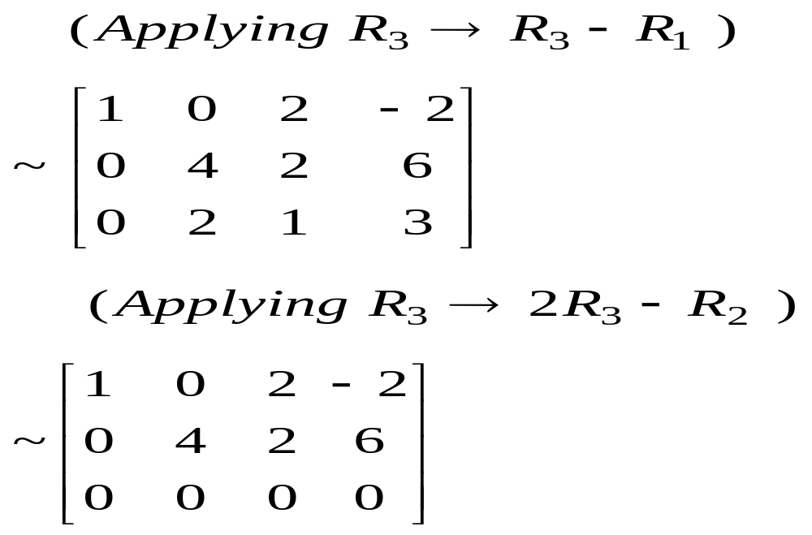

Slide 40
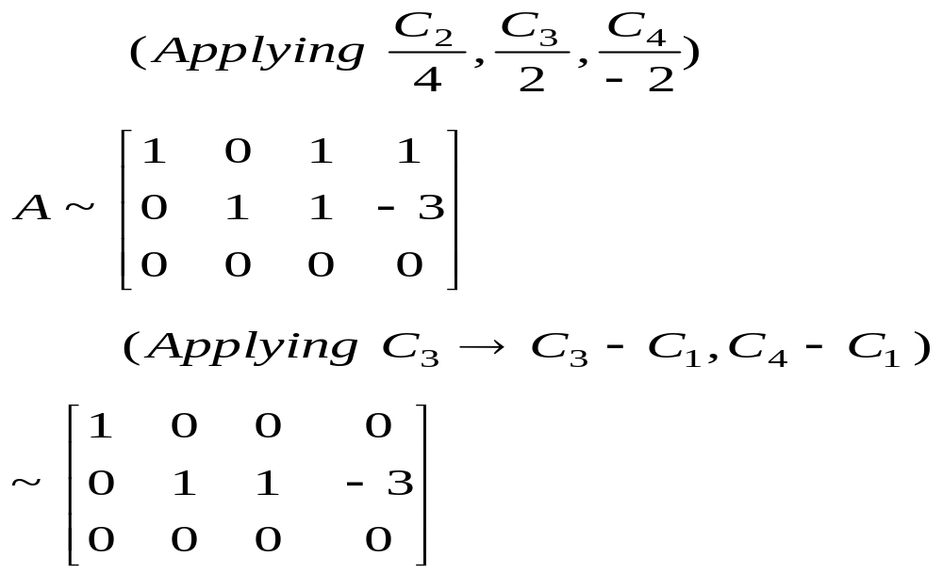
Contd..

Slide 41
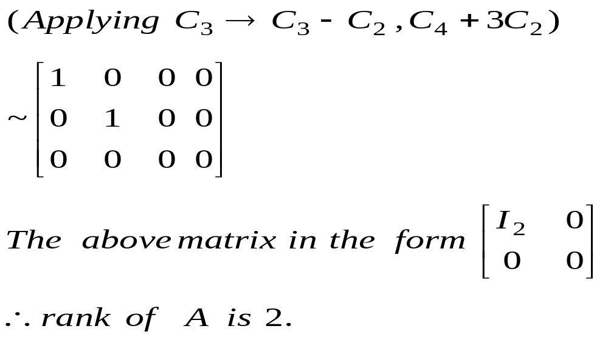

Slide 42
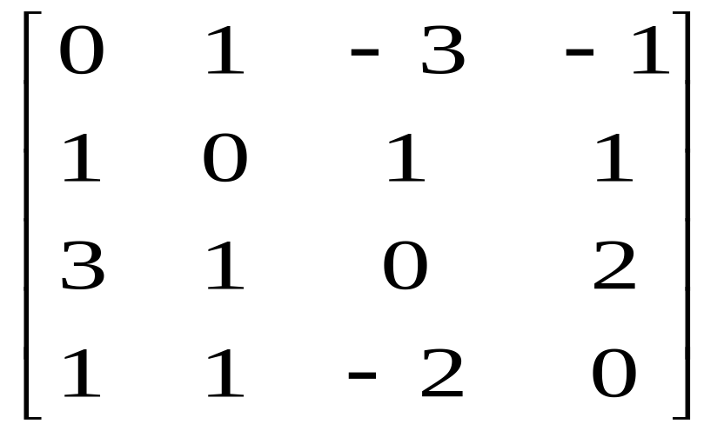
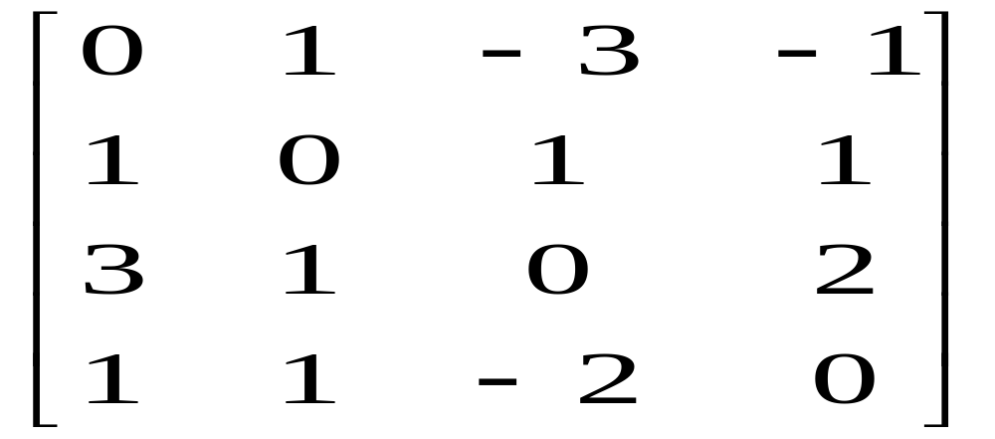
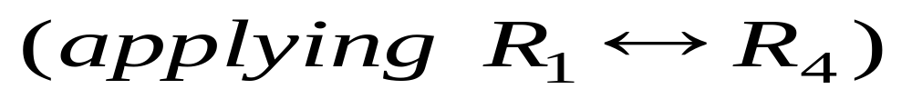
e.g. 3) Find the rank of
reducing it to normal form.
Sol : Let A =

Slide 43
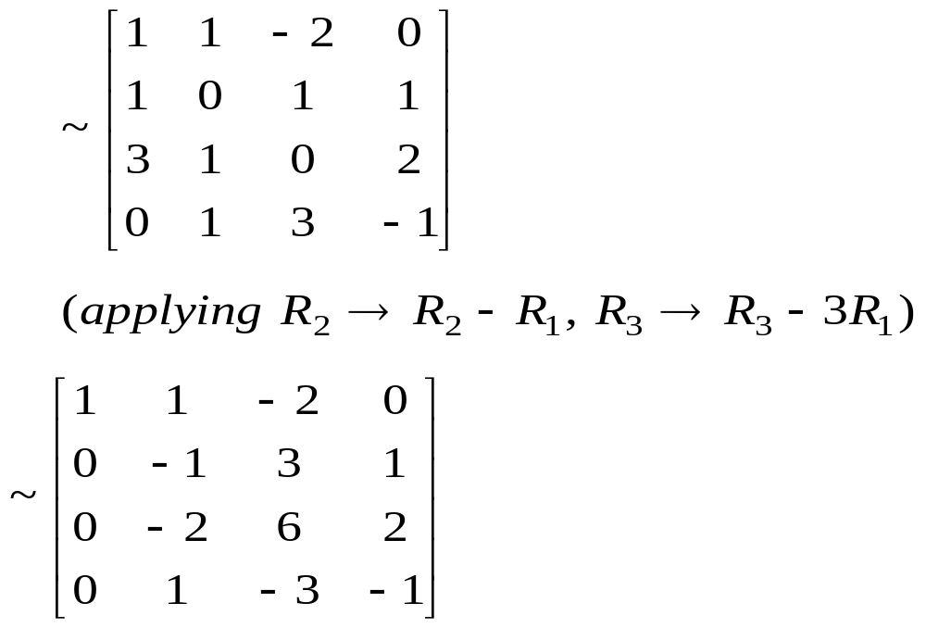
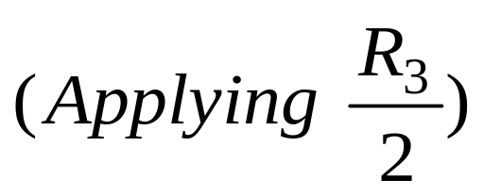

Slide 44
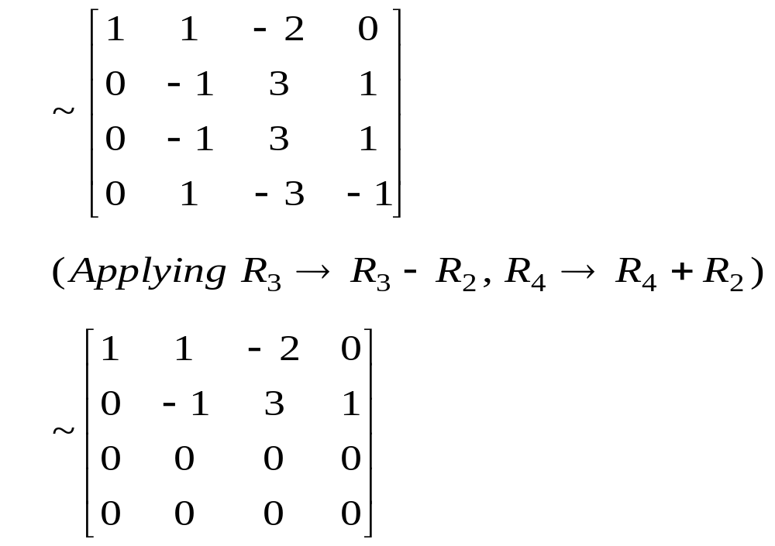
Continued…

Slide 45
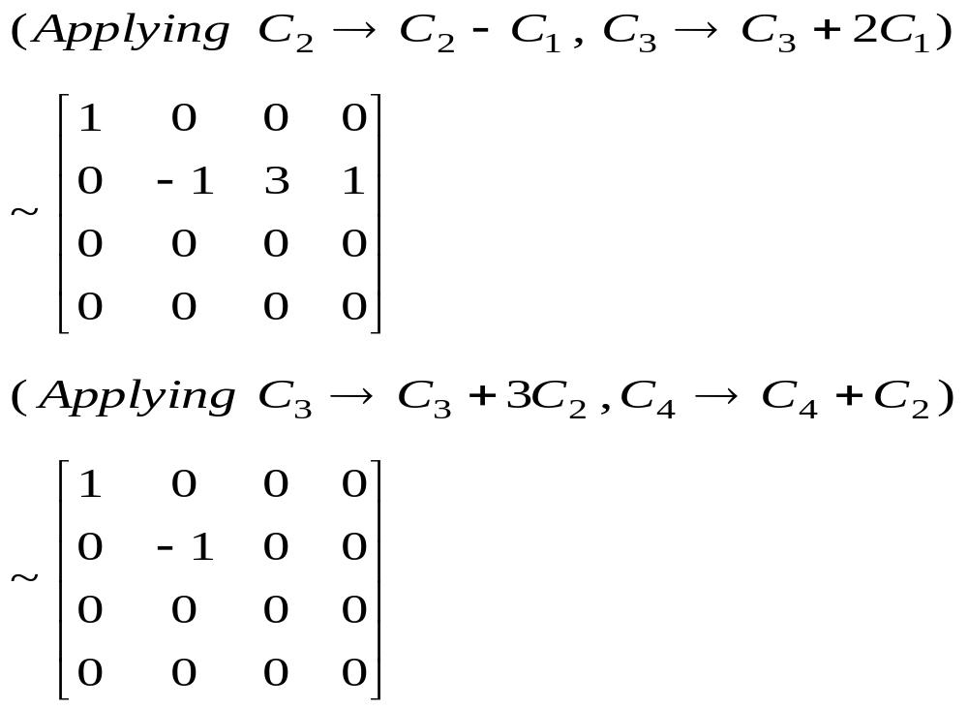

Slide 46
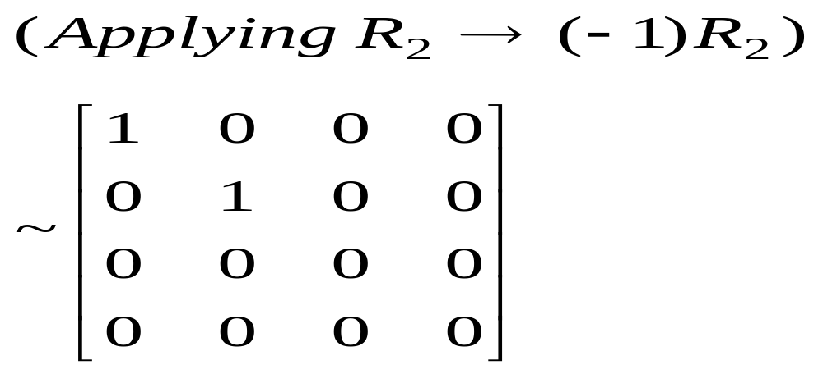
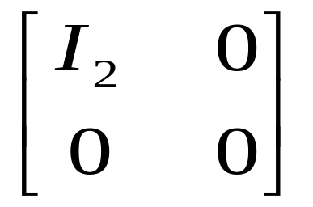
This is in the form (normal form).
Hence the rank of matrix A is 2.

Slide 47
We discuss the following in next Lecture:
1. Linear dependence and independence of vectors.
2. System of linear simultaneous equations.
3. Homogeneous and Non-homogeneous system.
4. Trivial and non-trivial solution.

Slide 48
MATHEMATICS FOR BIOTECHNOLOGY –II
UNIT-I
Lecture-3
System of linear simultaneous equations
Dr.c.vijender
Associate Professor of Mathematics
SNIST

Slide 49
We discussed the following in previous Lecture:
Echelon form of a matrix).
Normal form of a matrix.

Slide 50
We discuss the following in today’s Lecture:
Linear dependence and independence of vectors.
System of linear simultaneous equations.
Homogeneous and Non-homogeneous system.
Trivial and non-trivial solution

Slide 51
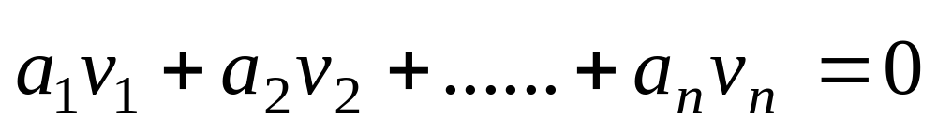
1. Linear Dependence and Independence of Vectors :
The vectors in a subset S = { V_{1 ,} V₂ ….. V_{n}} of a vector space v are said to be linearly dependent, if there exist a finite number of distinct scalars a_{1,} a_{2,} ………a_{n} not all zero,
such that

Slide 52

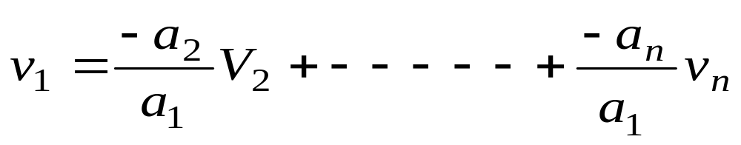
Where denotes the zero vector.
Notice that if not all of the scalars are zero, then at least one is non-zero, say, a_{1,} in which case this equation can be written as in the form

Slide 53
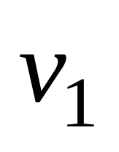
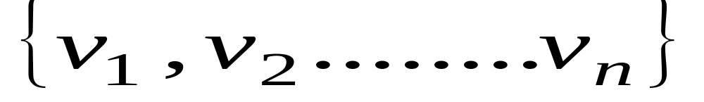
Thus is shown to be a linear combination of the remaining vectors.
The vectors in a set T= are said to be linearly independent if the equation

Slide 54
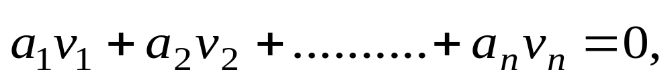
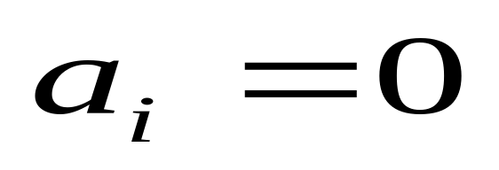
can only be satisfied by for i = 1, 2, …..n.
This implies that no vector in the set can be represented as a linear combination of the remaining vectors in the set.

Slide 55
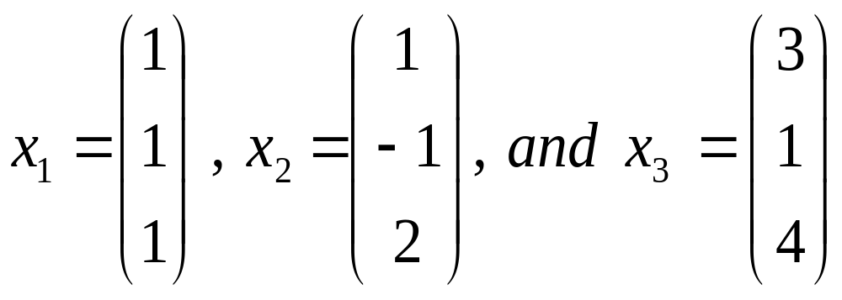
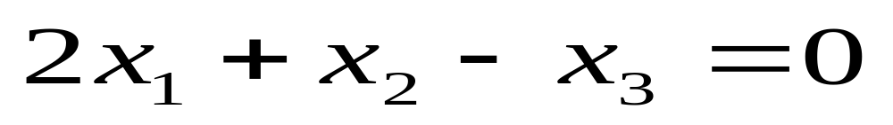
Linear dependence and independence Examples :
The vectors
are linearly dependent because

Slide 56
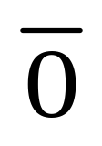
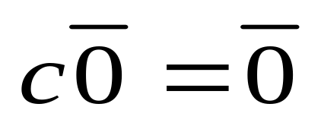
Any set containing the vector is linearly dependent, because for any c ≠ o,
In principle, it is an easy matter to determine whether a finite set S is linearly dependent. We write down a system of linear algebraic equations and see if there are solutions. For instance suppose

Slide 57
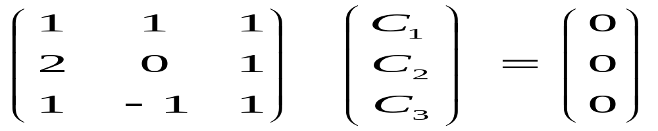
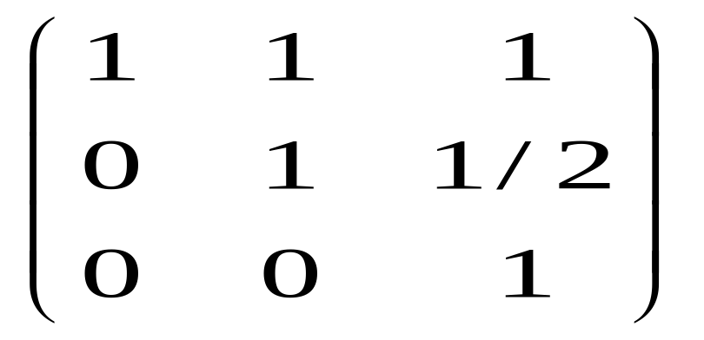
Evidently, the set S is linearly dependent if and only if there is non trivial solution to this homogeneous equation. Row reduction of the matrix leads quickly to

Slide 58
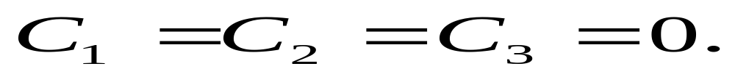
This matrix is non-singular, so the only solution to the homogeneous equation is the trivial one with
So the vectors are not linearly dependent.

Slide 59
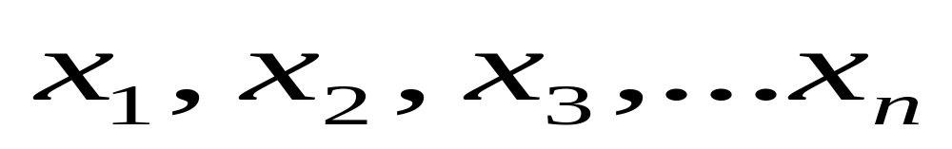
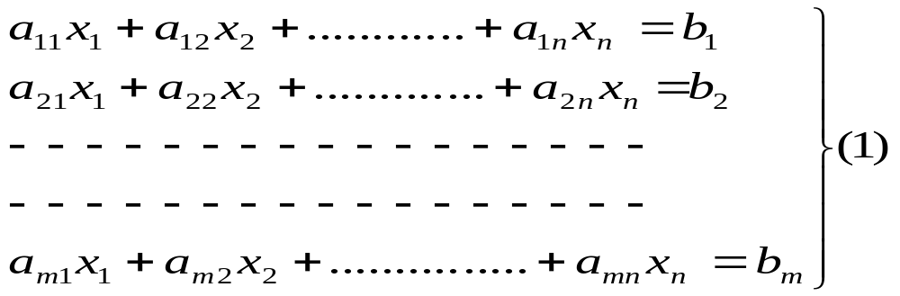
2. System of linear simultaneous equations :
Consider the system of m simultaneous equations in n unknowns as given below.

Slide 60



Where and are constants.
An ordered n-tuple satisfying all the equations in (1) simultaneously is called a solution of the system (1)
Given a system (1) , we do not known in general whether it has a solution or not. If there

Slide 61

is at least one solution for (1), the system is said to be consistent. If (1) does not have any solution , the system is said to be inconsistent. The system of equations in (1) can be conveniently written in a matrix form as Ax=B ………. (2)
where A = ,

Slide 62

The matrix [A,B] is called the augmented matrix of the system (1). By reducing [A,B] to echelon form, all the questions related to the existence and uniqueness of the solutions of AX = B can be answered.

Slide 63
3. Homogeneous and Non-homogeneous system:
If B = 0 in (2), the system is said to be homogeneous. Otherwise the system is said to be non – homogeneous.
4. Trivial and non-trivial solution :
The system AX=0 is always consistent since X=0 (i.e,x₁ =0 , x₂=0 , …..x_{n}=0 ) is always a

Slide 64
solution of Ax = 0. This solution X=0 is called a trivial solution of the system.
The system AX=0, whether it has a solution X≠0, such a solution , if exists, is called a non-trivial solution.
e.g.1) Consider, 2x+3y=0, 3x-2y = 0.
Here, x = 0, y = 0 is a solution. We can not find

Slide 65
another solution. Here, x=0, y = 0 is unique solution.
e.g 2) Consider 2x+3y = 0, 4x+6y = 0
Here x=0 y=0 is a solution of the system .
Further (-3k, 2k), where k is any number is also a solution of the system.
Taking k=1 , (-3, 2) is a solution of the system.

Slide 66
Hence the above homogeneous system has also non-trivial solution.
In fact, it has infinitely many non-trivial solutions.
e.g 3) consider, 2x+3y = 5, 3x+2y = 5.
This system does not posses any solution.

Slide 67
This is an inconsistent system as the two equations can not simultaneously be satisfied by any x, y.
Note: A given system of m equations in n unknowns, may or may not have a solution whether m<n or m = n or m>n

Slide 68
We discuss the following in next Lecture:
Solution of Linear systems by Gauss-Elimination Method.
Solution of Linear equations by Rank Methods.

Slide 69

MATHEMATICS FOR BIOTECHNOLOGY –II
UNIT-I
Lecture-4
Solution of linear equations
Dr.c.vijender
Associate Professor of Mathematics
SNIST

Slide 70
We discussed the following in previous Lecture:
Linear dependence and independence of vectors.
System of linear simultaneous equations.
Homogeneous and Non-homogeneous system.
Trivial and non-trivial solution

Slide 71
We discuss the following in Today’s Lecture:
Solution of Linear systems by Gauss-Elimination Method.
Solution of Linear equations by Rank Methods.

Slide 72
1. Solution of Linear systems :
Gauss Elimination Method :
This method of solving a system of n linear equations in n un-knowns consists of eliminating the coefficients in such a way that the system reduces to upper triangular system which may be solved by backward substitution.

Slide 73

e.g 1) Solve the equations
using Gauss – Elimination method.
Sol : The augmented matrix of the given system is
[A, B] =

Slide 74

This augmented matrix corresponds to the following upper triangular system.

Slide 75



By backward substitution
The solution is

Slide 76

e.g.2) Solve the system of equations 3x+y-z = 3, 2x-8y+z=-5, x-2y+9z =8 using Gauss elimination method.
Sol : The augmented matrix is
[A, B] =

Slide 77


[A, B] =

Slide 78



Slide 79
From this we get
X-2y+9z = 8,
-4y-17z = -21,
-33 z = -33 ⇒ z=1
From back substitution y = 1, x = 1
∴ The solution is x = 1 , y = 1 , z=1.

Slide 80
2. Solution of Linear equations by Rank Methods :
The system AX=B is consistent i.e., it has a solution (unique or infinite ) if and only if rank of A = rank of [A, B]
If rank of A=rank of [A, B]= r = n, the system has unique solution.

Slide 81
ii) If rank of A= rank of [A, B] = r < no of unknowns, the system is consistent , but there exists infinite no of solutions. Giving arbitrary values to n-r of the unknowns, we may express the other r unknowns in terms of these.

Slide 82
To obtain solutions, set (n-r) variables any arbitrary value and solve for the remaining unknowns.
iii) If rank of A ≠ rank of [A, B] the system is inconsistent . It has no solution.

Slide 83

e.g.1) Solve the system of linear equations by rank method x+y+z=6, 2x+3y-2z=2, 5x+y+2z =13.
Sol : The augmented matrix is
[A, B] =

Slide 84


Slide 85
Rank of A = 3, Rank of [A,B] = 3
Rank of A = Rank of [A,B] = 3 = no of unknowns
The given system is consistent and has unique solution
x+y+z = 6 , y-4z=-10 , -19z = -57
z = 3 , y = 2 , x=1

Slide 86
Therefore, x=1 , y = 2 , z = 3 is the solution.
e.g 2) Discuss for what values of λ, μ the simultaneous equations x+y+z = 6, x+2y+3z =10, x+2y+λz=μ have i) no solution ii) a unique solution iii) an infinite number of solutions

Slide 87


Sol : The augmented matrix is

Slide 88

Case I : no solution
Suppose λ=3 and μ ≠10, then we can see that rank of A=2 and rank of [A,B]=3.

Slide 89
Since rank of A ≠ rank of [A,B], we say that the system of equations has no solution (inconsistent).
Case II : a unique solution
Suppose λ≠3, then rank of A = 3 and rank of [A,B]=3. Here the number of unknowns is 3.
Rank of A = rank of [A,B] = no of unknowns

Slide 90

The system of equations will have a unique solution. This is true for any value of .
Case III : An infinite number of solutions :
Let λ = 3 and μ=10, then we have, rank of A = rank of [A,B] =2.
The given system of equations will be consistent.

Slide 91
But, here rank of A = rank of [A,B] =2 < the number of unknowns=3.
Hence, the system has infinitely many solutions.
e.g 3) Find the value of λ for which the system of equations 3x-y+4z=3, x+2y-3z=-2, 6x+5y+λz =-3 will have infinite number of

Slide 92

solutions and solve them with that λ value.
Sol : The augmented matrix
[A,B] =

Slide 93



Slide 94
If λ=-5, rank of A = 2 and rank of [A,B]=2
No. of unknowns = 3
Rank of A = Rank of [A,B] = 2 < no. of unknowns = 3
Hence, when λ=-5, the given system is consistent and it has an infinite no of solutions.
If λ = -5 , the given system becomes,

Slide 95


Let z=k,

Slide 96

Then, (2)
(1)
is the solution.

Slide 97
e.g 4) Find the value of p and q so that the equations
have (i) No solution (ii) Unique solution (iii) An infinite number of solutions.

Slide 98

Solution: Given equations are
The equations can be written in the matrix form AX=B

Slide 99


The augmented matrix is
[A,B]=

Slide 100
Case-I: No Solution: When p=5, q≠9
Then rank(A)=2 and rank ([A,B])=3.
The system will be in consistent. The system will not have any solution.
Case-II: Unique Solution: When p ≠5
Then rank(A)=3 and rank ([A,B])=3, no. of variables=3.

Slide 101
Case-III: Infinite no. of Solutions:
When p=5, q=9.
Then rank(A)=2 and rank ([A,B])=2, no. of variables=3.
The system will be consistent and will have infinite solutions.

Slide 102
We discuss the following in next Lecture:
Consistency of system of homogeneous linear equations.
Solution of homogeneous equations

Slide 103
MATHEMATICS FOR BIOTECHNOLOGY –II
UNIT-I
Lecture-5
SOLUTION OF HOMOGENEOUS EQUATIONS
Dr.c.vijender
ASSOCIATE PROFESSOR OF MATHEMATICS
SNIST

Slide 104
We discussed the following in previous Lecture:
Solution of Linear systems by Gauss-Elimination Method.
Solution of Linear equations by Rank Methods.

Slide 105
We discuss the following in today’s Lecture:
Consistency of system of homogeneous linear equations.
Solution of homogeneous equations

Slide 106

1. Consistency of system of homogeneous linear equations:
Consider a system of m homogeneous linear equations in n unknowns, namely

Slide 107

We write the above system as AX=0, where
Then system (1) can be written as AX=0 which is the matrix equation.

Slide 108


Here A is called the coefficient matrix. It is clear that is a solution of (1)
is a solution of (2).

Slide 109
This is called trivial solution of AX=0.
This AX=0 is always consistent, i.e., it has a solution.
The trivial solution is called the zero solution.
A zero solution is not linearly independent, i.e., it is linearly dependent.

Slide 110
Theorem: The number of linearly independent solutions of the linear system AX=0 is n-r, r being the rank of the matrix A_{mxn} and n being the number of variables.
Note: 1. If A is a non-singular matrix (i.e., detA≠0) then the linear system AX=0 has only the zero solution.

Slide 111
2. The system AX=0 possess a non-zero solution if and only if A is a singular matrix.
2. Working Rule for Finding the solution of the Equation AX=0:
Let rank of A=r and n= no.of variables.
I(i) If r=n, then the system of equations have only trivial solution (i.e., zero solution).

Slide 112
(ii) If r<n, then the system of equations have an infinite number of non-trivial solutions, we shall have n-r linearly independent solutions.
To obtain infinite solutions, set (n-r) variables any arbitrary value and solve for the remaining unknowns.

Slide 113
If the no.of equations is less than the no.of unknowns, it has a non-trivial solution. The no. of solutions of the equation AX=0 will be infinite.
II. If the no.of equations is less than number of variables, the solution is always other than a trivial solution.

Slide 114
III. If the no.of equations=no.of variables, the necessary and sufficient condition for solutions other than a trivial solution is that the determinant of the coefficient matrix is zero.

Slide 115

e.g.1 Solve the system of equations
Sol: Let

Slide 116


Then the given system can be written as AX=0.
Now

Slide 117

Thus the matrix is in Echelon form. Number of non-zero rows is 2.
Therefore rank of the matrix is 2.

Slide 118

Since number of variables is 3, this will have 3-2=1 non-zero solution.
The corresponding equations are
Let z=k. Then

Slide 119

Which is the general solution of the given system.

Slide 120
e.g.2 Determine whether the following equations will have a non-trivial solution if so solve them.
Solution: Given equations will have a non-trivial solution sine the number of equations is less than the number of unknowns.

Slide 121
In other words the system will have a non-trivial solution if and only if the rank r of the coefficient matrix is less than n the no. of unknowns.
Give equation can be written in the matrix form as follows:

Slide 122


Or (Interchanging the variables x and z)

Slide 123

We shall now reduce the coefficient matrix A to the echelon form by applying only elementary row operations.

Slide 124



Slide 125
Thus the matrix A has been reduced to Echelon form.
Therefore Rank(A)=No.of no-zero rows =2<4(Unknowns)
Hence the given system will have 4-2=2
i.e., 2 linearly independent solutions.

Slide 126

Now the given system of equations is equivalent to
i.e., z+2y+4x+3w=0 and y+2x+w=0
Choose x=k₁ and w=k₂. Then solving two equations, we get

Slide 127

x=k_{1,} y=-2k₁-k₂, z=-k₂ and w=k₂, where k₁ and k₂ are arbitrary constants.
e.g. Solve completely the system of equations:

